Slide 1

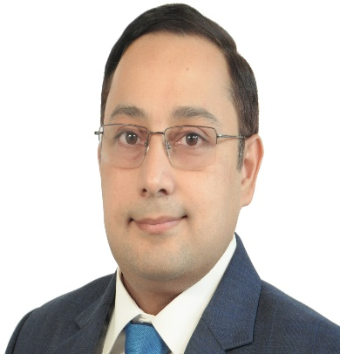
Viswanath P
FICWAI, PGDBA
Partner, Growth
Experience
20+ years experience, across consulting and industry in the areas of transformation, strategy, program management, organization alignment, enterprise performance management, change management, M&A, Turnaround
Worked with Promoters and CXOs to accelerate implementation of strategies / transformation programs by establishing the strategy office, enabling action through appropriate governance and aligning actions to strategies of the business
Led 7 large scale transformation programs covering people, process and technology across manufacturing, FMCG, retail, fashion, diversified businesses, 35+ Strategy/ CDD / GTM engagements and 4 post merger integrations
Sector experience
Retail, FMCG, Consumer Durables, Fashion & Textiles, Auto
Professional qualifications and memberships
Associate Member of the Institute of Cost Accountants of India
Post Graduate Diploma in Management
Certification in Digital Transformation for Business
Teaching exposure
Visiting faculty to T.A.Pai Management Institute, K J Somaiya
Presentations and publications
Regular speaker on business transformation at CII, India Food Forum

