Slide 1

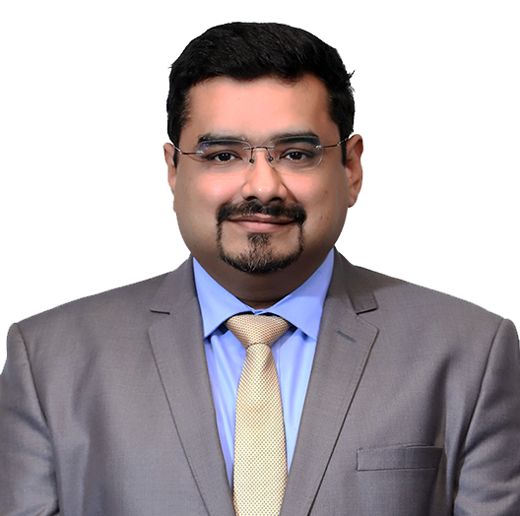
Vikarth Kumar
MRICS, ICVS, CFA, MBA, Registered Valuer (IBBI)
Partner, Growth
Experience
Vikarth has over 20 years of experience in corporate finance services. With a specialisation in valuations practice, he has executed many valuation engagements to support clients in both their strategic objectives and for compliance with statutory and reporting regulations.
Vikarth has undertaken valuations for mergers and acquisitions or corporate restructuring, early stage companies for PE or venture capital funding, intangibles assets such as brands and intellectual property, stock options under various GAAPs, litigation support, delisting, RBI compliance, accounting and reporting under various GAAPs, and portfolio of investments for private equity.
He has handled international engagements along with other Grant Thornton International member firms in Vietnam, Thailand, and Cambodia, and has collaborated closely on valuation engagements with Grant Thornton US, European and UK offices.
Sector experience
Energy and power, industrials, consumer, healthcare, IT, real estate and infrastructure, mining and metals, and financial services
Professional qualifications and memberships
Registered Valuer with the Insolvency and Bankruptcy Board of India (IBBI)
ICVS (International Association of Certified Valuation Specialists)
MRICS (Royal Institution of Chartered Surveyors), CFA Institute USA
Indian Association of Investment Professionals (IAIP)
MBA (Finance), University of Mumbai
Indian Institute of Management (IIMB)
Community involvement
Actively involved in working for elderly homeless people, a school for the visually impaired, and animal welfare

Slide 2
Presentations and publications
Regular speaker on valuations at VC Circle events
Presented on valuations for PE at IPO and Private Equity conclave
Actively contributed on thought leadership publications such as The Fourth Wheel: Private Equity in the Indian Corporate Landscape and insights for private equity and venture capital firms
Languages spoken
English, Hindi and couple of regional languages.
Contact details
Grant Thornton India LLP
21st floor, DLF Square, Jacaranda Marg, DLF Phase II, Gurugram – 122002,
India
T +91 80 4243 0728
M +91 99005 18729
E Vikarth.Kumar@in.gt.co.in

