Slide 1

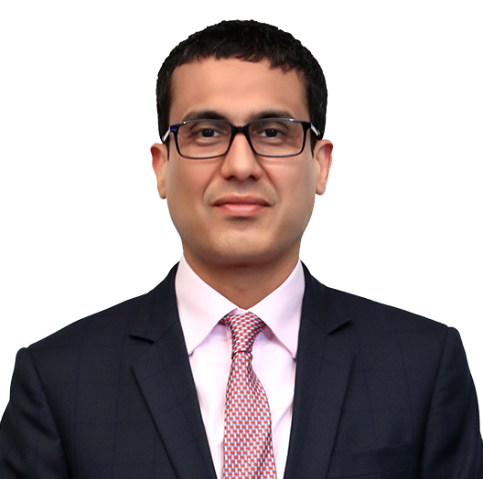
Triven Gupta
Post Graduate Diploma in Business Management
BBA (Finance and MIS)
Partner, Global delivery
Experience
Triven comes with over 18 years of overall experience across international markets. During the initial years of his career, Triven worked for start-up companies in the USA, and joined leading consulting and professional services firms after returning to India.
He has played an important role in setting up of global delivery services for Grant Thornton in India. As part of the global delivery team, Triven currently leads the Global Research Centre (GRC), which provides secondary research, survey and analytics, as well as process support to GTIL and the global member firm network.
Before joining the global delivery team at the Firm, Triven was part of the advisory team, and worked with clients across Africa, Asia, Europe and the USA on execution of industry and market assessment, business planning and strategy, international expansion, and partner search projects.
Sector experience
Food and beverage, and consumer
Professional qualifications and memberships
Post Graduate Diploma (MBA) in Business Management
BBA from The University of Texas, Austin, USA
Languages spoken
English and Hindi
Contact details
Grant Thornton Advisory Private Limited
21st floor, DLF Square
Jacaranda Marg, DLF Phase II,
Gurugram – 122002 India
T +91 124 462 8000
M +91 98104 23962
E Triven.Gupta@in.gt.com

