Slide 1

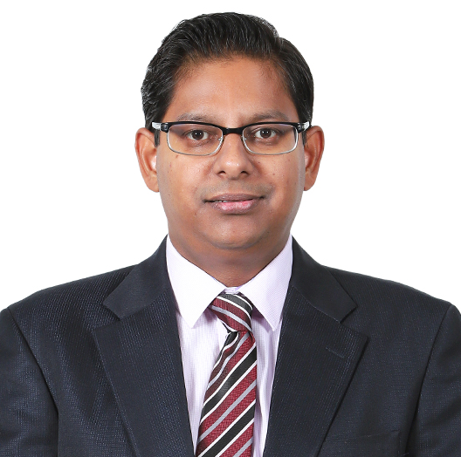
Shalabh Saxena
PGDBM, Finance
Partner, Risk
Experience
Shalabh is a risk and compliance professional with global business experience in financial, information systems, operational and regulatory auditing, Sarbanes-Oxley 404 compliance, business process evaluation and design, and fraud investigation.
He has over 23 years of experience of leading CXO Advisory mandates in diverse geographies including the US, Europe, UK, and APAC for significantly large multinational corporations and for large and mid-sized promoter-driven business groups in India.
Shalabh is currently working as an Internal Audit Partner on several engagements including large listed companies with reporting to the audit committee.
He also represents Grant Thornton India on the Grant Thornton Global Business Risk Service Leadership Group.
Shalabh is also leading the role of the Risk Leader for Tech (Technology, Media & Services) Risk in north.
Specialties: Internal Audit and SOX, enterprise risk management,
process reviews, controllership in SSC environment/ process transitions, governance, and compliances.
Before joining Grant Thornton in India, Shalabh worked with Axis Risk Consulting, a niche global risk consulting firm, which was a subsidiary of an NYSE listed company, a large professional services firm, and B K Birla Group, a large Indian business house as a finance controller
Sector experience
Technology, media, financial services, automotive, and manufacturing
Professional qualifications and memberships
PGDBM, Finance
Trained and tested in Six Sigma Green belt
Community involvement
Participated in the CSR activities led by the Firm
Languages spoken
English and Hindi
Contact details
Grant Thornton India LLP
Plot No. 19A, 7th Floor,
Sector – 16A,
Noida - 201 301 India
T +91 120 485 5901
M +91 92120 32364
E Shalabh.saxena@in.gt.com

