Slide 1

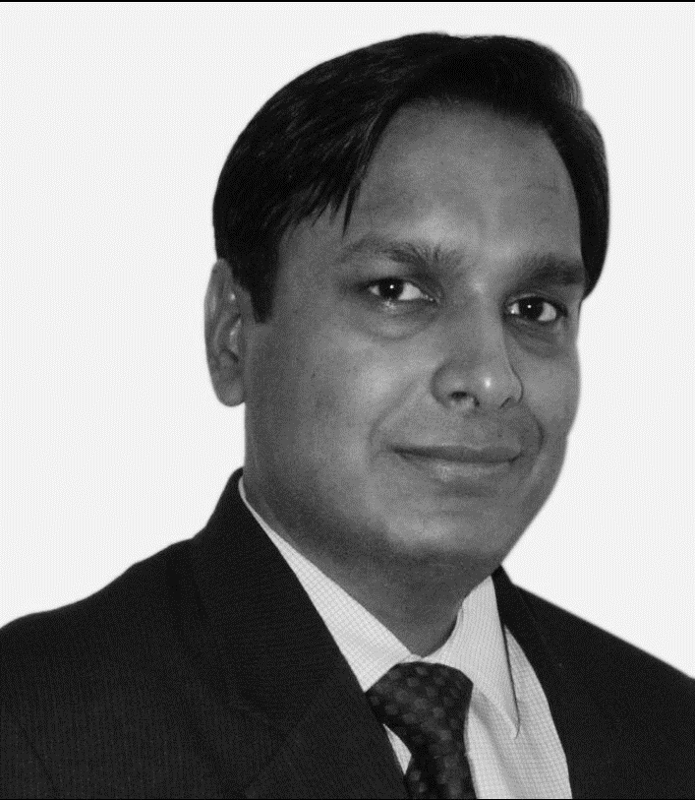
Rajeev Jain
Chartered Accountant (CA)
Partner, Transfer pricing
Experience
Rajeev has more than 20 years of experience and is associated with TP since its introduction in the Indian legislations by the Finance Act 2001. He has worked on various TP assignments that include compliance, documentation, including CbCR, Master File and Local File, planning, business model / price structuring etc.
He has extensive experience in TP litigation and has represented various complex TP matters before the tax authorities. He has also worked on MAPs and on numerous bilateral as well as unilateral APAs. He has been involved in APA assignments for complex transactions like management service charges, royalty, PE attribution etc.
Rajeev is a regular speaker at professional forums and contributes on transfer pricing topics for national and international publications.
He has led the TP - Transfer of competency training for the GTI member firms in African region to help them understand TP and set-up their local TP practice.
Sector experience
Media and entertainment, publishing, auto ancillary, IT/ ITES, industrial manufacturing, engineering, etc.
Professional qualifications and memberships
Member of Institute of Chartered Accountants of India (ICAI)
Languages spoken
English and Hindi
Contact details
Walker Chandiok & Co LLP
Plot No. 19A, 2nd Floor,
Sector – 16A, Noida - 201 301 India
T +91 120 485 5999
M +91 9810592280
E Rajeev.Jain@WalkerChandiok.IN

