Slide 1

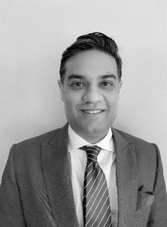
Rahul Kapur
Chartered Accountant (CA)
Partner, Growth
Experience
Rahul is a Partner with Grant Thornton and leads the firm’s consulting practice. With over 19 years of professional services experience, Rahul is a Chartered Accountant with diverse functional experience of assisting companies with business planning, growth strategy, process validations and operational improvements, setting up shared services centers etc.
Rahul was recently awarded the ‘Global Leaders in Consulting’ award by ‘The Consulting Magazine’ in 2019 and the ‘Management Consulting award by ‘The CEO today Magazine’ in 2020
Rahul has also assisted clients across several geographies apart of India including USA, UK, Spain, Italy, Kuwait, Egypt, Malaysia, Cambodia and UAE. Rahul was also seconded to the New York City office of Grant Thornton USA in 2005-2006 where he worked with the Wall Street clients of the firm
Rahul started his career in 2000 with Arthur Andersen India and also worked with Ernst & Young India before joining Grant Thornton India in 2004. Since then,
Rahul has been a part of the growth journey of the firm witnessing the firm growth from 70 people to 6,000 people
Rahul is on the panel of experts to conduct commercial and financial due diligence on behalf of National Skill Development Corporation and Asian Development Bank. Rahul is also an active speaker on varied topics with TIE, FICCI, CII, UKIBC, ASSOCHAM etc.
Rahul has also authored several whitepapers on industry and functional aspects
Sector experience
Retail, FMCG, education, ecommerce, healthcare, pharma, auto & auto components, agriculture, vocational studies, energy sector and food & beverage sectors
Professional qualifications and memberships
Chartered Accountant (CA)
Community involvement
Participated in the CSR activities led by the Firm
Languages spoken
English and Hindi
Contact details
Grant Thornton India LLP
Grant Thornton Bharat LLP
21st floor, DLF Square, Jacaranda Marg, DLF Phase II,
Gurgaon - 122002,
Haryana, India
T +91 12 4462 8000
M +91 98112 10501
E Rahul.kapur@in.gt.com

