Slide 1

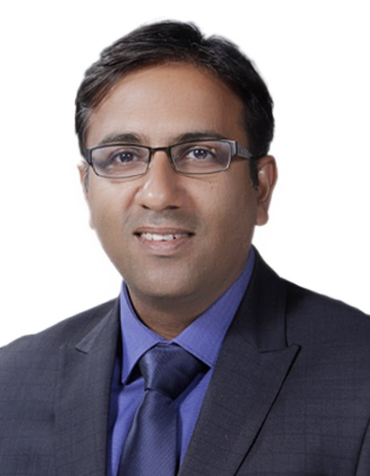
Kshitij Sharma
MBA, BE, CSCP (APICS),SCOR Certified professional
Executive Director, Growth
Experience
Kshitij is an experienced Supply chain and operations professional responsible for leading supply chain transformation initiatives for clients across sectors
He has around 18 years of experience across management consulting and within Industry and have worked across India, US and APAC geographies​
He has extensively worked across Growth strategy ,Operating Model Design, Supply Chain planning and design, Digital Strategy, performance improvement initiatives focused on designing agile and lean operations and delivering tangible improvements for Consumer and Industrial products companies
He has also contributed thought papers for CII on Advanced manufacturing, Digitization and analytics opportunities in Operations along with new product development opportunities for Steel sector
Before joining Grant Thornton in India, , Kshitij worked with other leading organizations like EY, Deloitte HCL, LG Electronics and helping organizations in improving their Supply chain performance
Sector experience
Consumer Products, White Goods, Pharma, Chemical, Textile, Steel, Auto, Paper and Packaging
Professional qualifications and memberships
MBA , NMIMS, Mumbai
AMPBA, Indian School of Business (ISB), Hyderabad
BE (Mechanical) , Delhi College of Engineering , Delhi
Certified Supply Chain Professional (CSCP), APICS
SCOR Certified Professional (Supply Chain Operations Reference Model ), APICS
Languages spoken
English and Hindi
Contact details
Grant Thornton Advisory Private Limited
21st floor, DLF Square
Jacaranda Marg, DLF Phase II,
Gurugram – 122002
India
T +91 124 462 8000
M +91 9971708681
E Kshitij.sharma@in.gt.com

