Slide 1

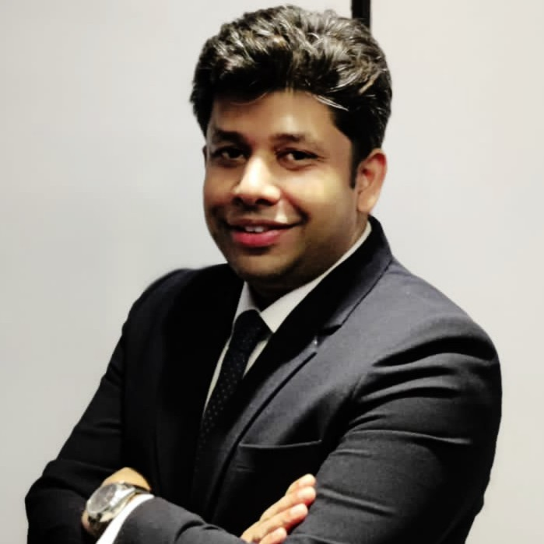
Karan Jain
PGDBM, Finance
Director, Growth
Experience
Karan has ~14 years of professional experience across verticals such as finance operations, corporate finance, and strategy consulting. Prior to working with Grant Thornton, he has worked with Bausch and Lomb, Tupperware and JP Morgan Chase in financial planning and analysis roles
Karan has extensive experience in financial forecasting & budgeting, financial modelling and business planning. He has also worked with clients in the area of strategy formulation & implementation, market assessment, due diligence and feasibility study
Karan has also assisted clients across several geographies apart of India including Kenya, Tanzania, Rwanda, Uganda, South Africa, Mozambique, Ethiopia, Ghana, United Kingdom, Switzerland, Australia, Qatar, UAE, Singapore and Hongkong
Karan has completed his Post Graduate Diploma in Business Administration from Symbiosis University- Pune
Sector experience
Infrastructure, education, ecommerce, healthcare, pharma, auto & auto components, agriculture, vocational studies, energy sector and food & beverage sectors
Professional qualifications and memberships
PGDBM, Finance
Community involvement
Participated in the CSR activities led by the Firm
Languages spoken
English and Hindi
Contact details
Grant Thornton India LLP
Grant Thornton Bharat LLP
21st floor, DLF Square, Jacaranda Marg, DLF Phase II,
Gurgaon - 122002,
Haryana, India
T +91 12 4462 8000
M +91 98713 00089
E Karan.jain@in.gt.com

