Slide 1

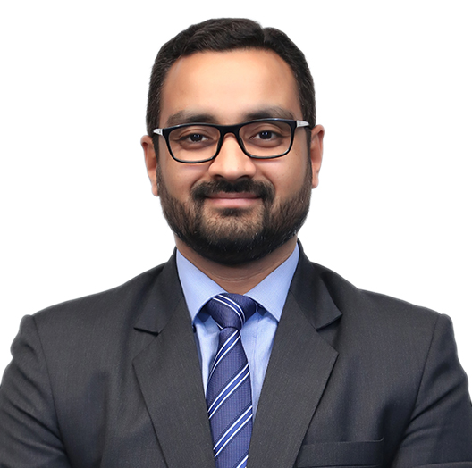
Devesh Uniyal
B.Com.
Partner, Compliance and outsourcing
Experience
Devesh comes with over 21 years of experience in the auditing and accounting domain. He is a seasoned professional, and has undertaken statutory audits and tax audits for a large number of clients involving financial reporting under Indian GAAP.
Devesh has maintained relationships with various CFOs and audit committees of large clients. This is how he gained insights into their decision-making process and understood the significance of stakeholder relationships and regulatory compliances.
Currently, Devesh is managing F&A function and regulatory compliances for over 100 Indian affiliates of multinational companies.
Sector experience
Infrastructure, information technology and IT-enabled services, pharmaceuticals, education, and general manufacturing
Professional qualifications and memberships
B.Com.
Languages spoken
English and Hindi
Contact details
Grant Thornton Advisory Private Limited Plot No. 19A, 7th Floor,
Sector – 16A,
Noida - 201 301
India
T +91 120 710 9001
M +91 98118 64644
E Devesh.Uniyal@IN.GT.COM

