Slide 1

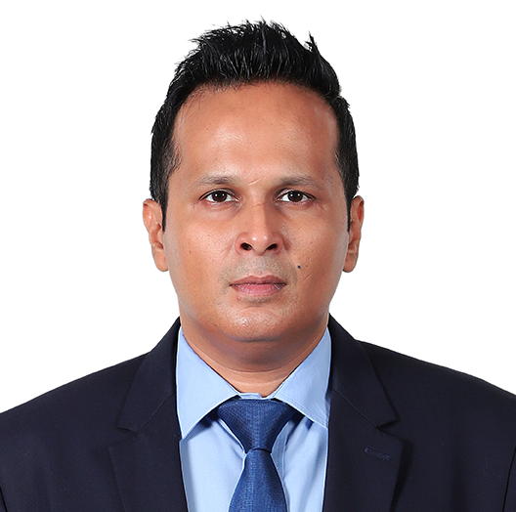
Anirudh Gupta
FCA, B Com (Hons.)
Partner, Growth
Experience
Anirudh is a Partner based out of New Delhi and focusses on developing the transaction advisory practice and the working capital management and optimization advisory practice of the firm. He is a Bachelor of Commerce (Honours) and Chartered Accountant.
Anirudh has over 16 years of experience in advisory and management consulting. Anirudh has worked in various capacities as a business solutions provider and advisor to diverse businesses, industries and sectors, both national and international. He has varied experience in Transaction Advisory Services (TAS), due diligence, valuations, business assurance, corporate and debt restructuring, mergers and acquisitions, loan syndication advising, working capital management and optimization advisory, project financing consultancy, financial and accounting reviews, bank settlements, risk and process advisory services, statutory audit, internal audit, limited reviews, concurrent audit, tax and legal compliance.
With Grant Thornton, his experience has been diverse and extensive, including financial due diligence reviews in connection with acquisitions and fundraising, viability and feasibility reviews, forecast assessment, deal and negotiation support and public company transactions. He has been involved in many transactions spanning different sectors and geographies involving both global and Indian Private Equities as well as Corporate Clients. He has professional experience spanning countries like USA, UK, Singapore, Japan, Canada, France, Spain, Italy, Sweden, Israel, South Korea, Germany, Netherlands, Brazil, South Africa, Kenya, Turkey, Indonesia, Sri-lanka, Nepal, Bangladesh, Hong-Kong, to name a few.
Sector experience
Consumer and Retail, Industrials, IT and ITES, Healthcare and Life Sciences, BFSI, Auto and Auto Components, Logistics, Agriculture, Real Estate, Pharma, various others.
Professional qualifications and memberships
Chartered Accountant, ICAI
Member, Valuer’s Guild of the Institute of Chartered Accountants of India
Bachelors of Commerce Honours, Delhi University
Community involvement
Actively involved in working with an NGO focussing on the upliftment of the girl child.

Slide 2
Presentations and publications
Guest speaker at events organized by various trade chambers, educational institutions, industrial and trade bodies, and trade associations.
Regular contributor to thought leadership publications such as The Fourth Wheel, Deal Tracker, etc.
Principal author of various industry specific publications like Start-Up India, Auto Sector Deal Environment, etc.
Languages spoken
English and Hindi.
Contact details
Grant Thornton India LLP
21st floor, DLF Square, Jacaranda Marg, DLF Phase II, Gurugram – 122002,
India
T +91 12 4462 8000
M +91 98102 25831
E Anirudh.Gupta@in.gt.com

